Slide 1



District Public Image Committee
Making Public Image Work for Hawaiʻi Rotary District 5000

Slide 2
2023-2024 Co-Chairs
Joshua Laguana (Hickam Pearl Harbor)
Scott Wishart (Ala Moana)

Slide 3
2024-2025 Co-Chairs
Joshua Laguana (Hickam Pearl Harbor)
Scott Wishart (Ala Moana)

Slide 4
Presidents-Elect Meeting

Slide 5
Publicimage@rotaryd5000.org
Joshua Laguana
(Hickam Pearl Harbor)
Scott Wishart
(Ala Moana)
Sandy Matsui
(Kaneohe)
Roz Cooper
(Metro)
Nicole Baltazar
(RECO)
Ted Faigle
(Poipu Beach)
Lori Williams
(Windward Lanikai)
Mark Merriam
(Metro Honolulu)
Konrad Ikei – RotaryD5000.org
(Ala Moana)
Ryan Kawamoto
(Kahala Sunrise)
Public image resource team
Who can you turn to?

Slide 6
How do I share my club’s activities with the district?

Slide 7
Options:
RotaryD5000.org
PublicImage@rotaryd5000.org
District Calendar
Facebook
Instagram
Newsletter
Notes:
Increase public awareness of Rotary by informing the public of Rotary activities
Educate the public about Rotary as a community organization by promoting and communicating what is happening within the district and at the club levels;

Slide 8
What can the Public Image Resource Team help with?

Slide 9
What we do…
Provide guidance and review club websites, flyers, & news releases
Facilitate training on the topic of Public Image to your club or committee
Notes:
Act as a resource to club and district committees to support the Public Image Committee mission;
Facilitate training sessions at District Assemblies and support clubs in preparation for District Conference;

Slide 10
What we do…
Share your club’s social media posts
Post stories on the district website
Update District Calendar
Notes:
Define objective differences between internal communications (Rotarians) and external communications (non-Rotarians).

Slide 11
The PI Team

Slide 12
Web Master
One of the most common ways people in a community learn about Rotary and the good we do is through a club or district website.
Our websites must inspire, be simple, and have a clear call to action.

Slide 13
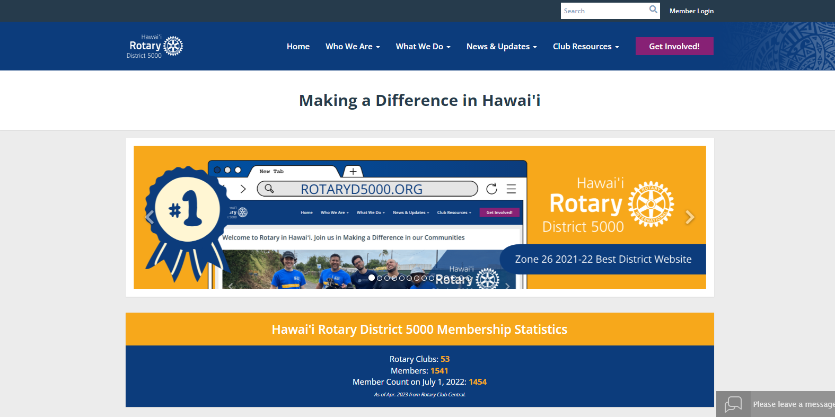
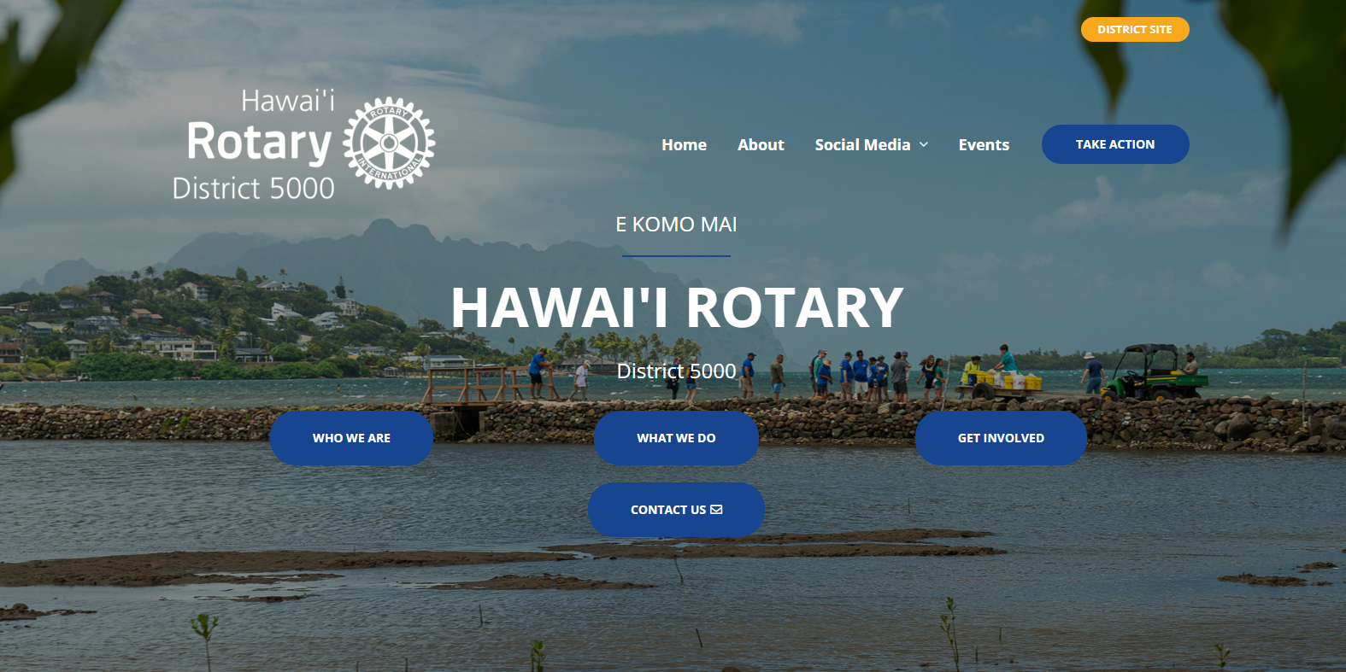
Web Master
The District manages two websites, one for Rotarians (internal audiences) and one for Non-Rotarians (external audiences).
For internal audiences: RotaryD5000.org.
For external audiences: RotaryInHawaii.org

Slide 14
Communications
District Committees and Clubs are encouraged to share their activities, events, and news on a larger and more coordinated effort through the District’s newsletter.
Have something to send out? Tell us your message and your targeted audience and we’ll guide you on the best avenue!

Slide 15
Social Media
We use social Media to promote activities of the district and individual clubs on multimedia platforms such as Facebook, Instagram, and YouTube.
The goal is to gain new followers, increase interactions with posts, and identify leads for new membership (Rotary, Interact, Rotaract, Donors, Partners, Volunteers).

Slide 16



Social Media
Official District Accounts:
Facebook @RotaryD5000 (internal)
Facebook @HawaiiRotary (external)
Instagram @HawaiiRotary
YouTube: @HawaiiRotary

Slide 17
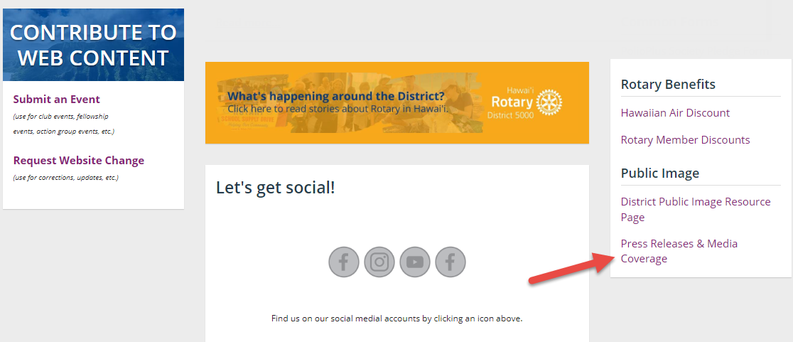
Public Relations
Develop Press / Media Releases and connect with Hawaiʻi Media Contacts

Slide 18
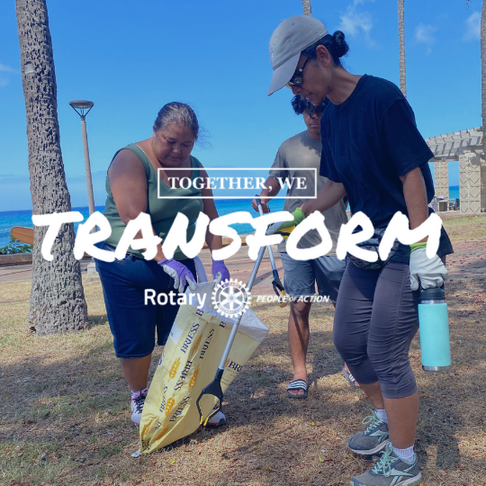

Photography
It is important to capture district and club events. Send your photos to us or tag us in a social media post.
Use the People of Action campaign

Slide 19
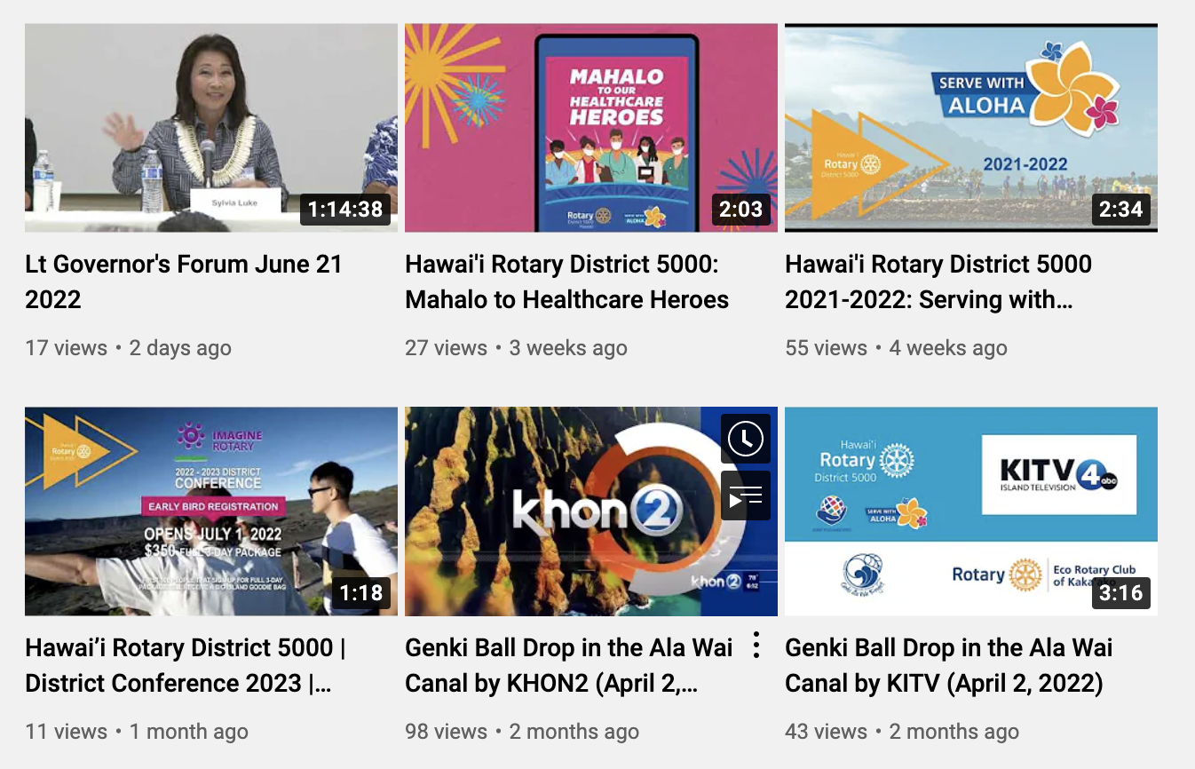
Videography
Create district wide videos that promote Rotary in Hawaii. Contact us to advise, assist and review video projects. Want to add a video to the Hawaii Rotary library? Send us your files!

Slide 20

Use Proper Branding
Ensure consistency in the Hawaii Rotary brand.

Slide 21
Things to know before you go

Slide 22

The District Logos
Official District Logo
Geographical logo for external use
Hawaiʻi with ʻokina

Slide 23


RI Theme 2023-2024
Vertical
Horizontal

Slide 24
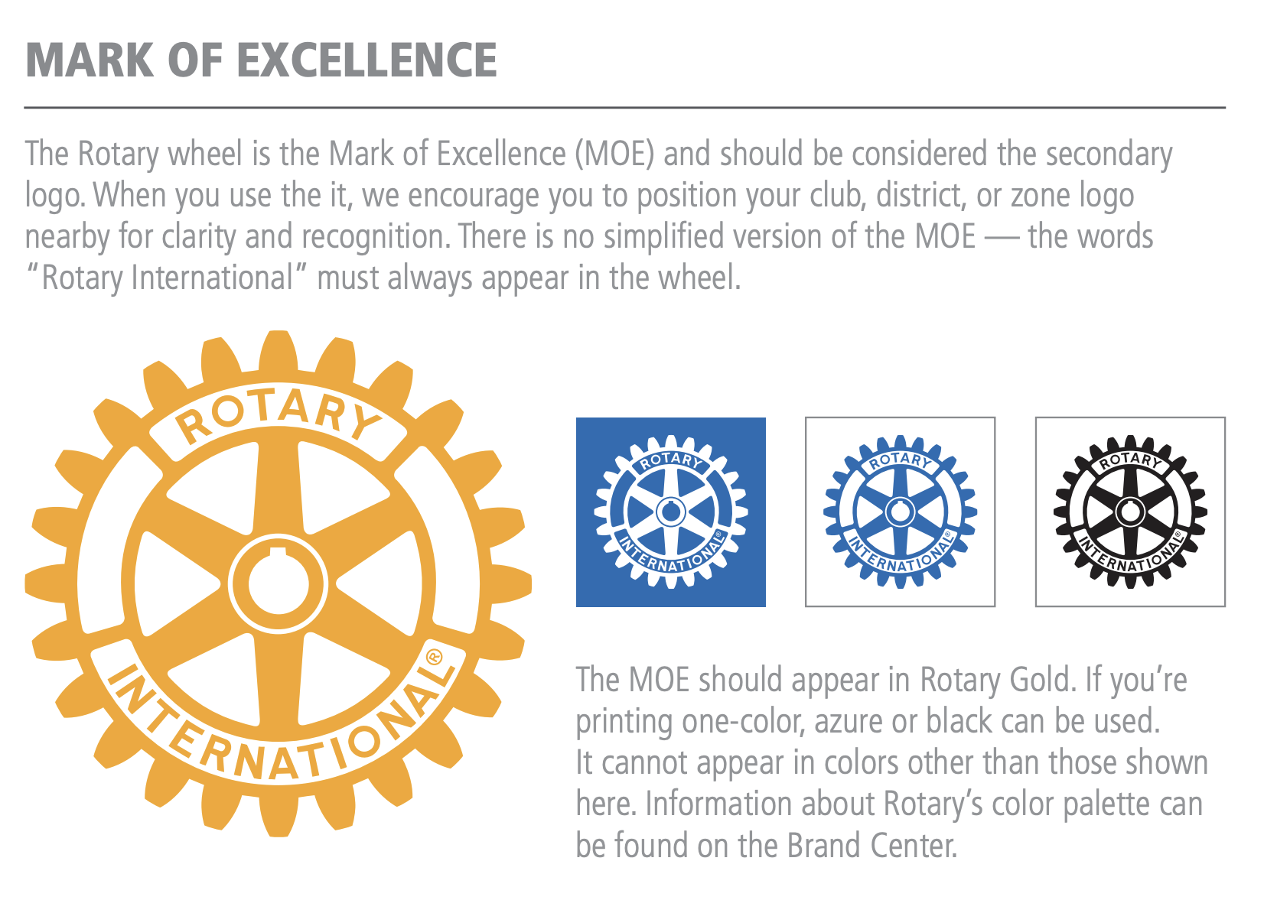
What’s the difference with the wheels?

Slide 25

Using the Right Logo

Slide 26
Bottom Line
Your Public Image Committee elevate the Rotary brand and promote Rotary in Hawaii.
You’re District Public Image Committee is here to support YOUR CLUB’S efforts.
Visit the District’s Public Image Resource Page RotaryD5000.org/Public-Image

Slide 27
Next Steps:
Create a Public Image Committee
Develop a strategic plan
Visit RotaryD5000.org/public-image
Download the logos and other assets
Submit your club’s POA photos online
Join the monthly meetings to stay up-to-date with District PI news
Recruit!!!!

Slide 28
Hawaiʻi Rotary District 5000
Public Image Committee Co-Chairs 2022-2024
Joshua Laguana (Hickam Pearl Harbor)
Scott Wishart (Ala Moana)
Our Contact Information
PublicImage@RotaryD5000.org
RotaryD5000.org/public-image

